Slide 1

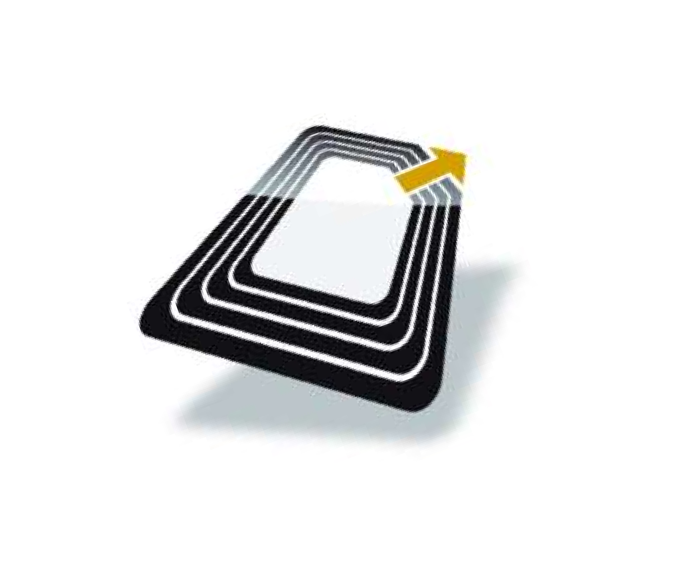
RFID BASED ATTENDANCE SYSTEM
By:-
Surya Saini (430)
Manan Aggarwal (414)
Dhanuj Kumar Sharma (004)

Slide 2
Index
Description
Working
Hardware Used
Types and Tags
Schematic Diagram
Working
Conclusion
Applications

Slide 3
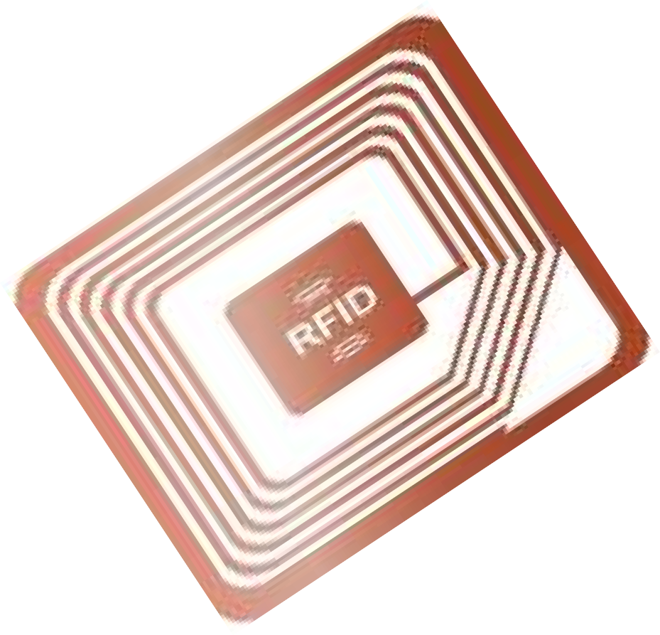
Description
RFID is an acronym for radio frequency identification.
RFID is a member of automatic identification and data (AIDC) technologies and is fast and reliable means of identifying just about any material object.
Active RFID tags are powered by an internal battery and are typically read/write i.e. tag can be rewritten and/or modified. An active tag’s memory size varies according to application requirements.

Slide 4
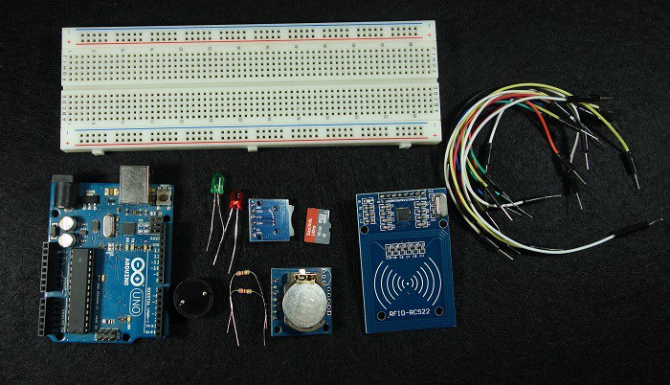
Hardware Used

Slide 5
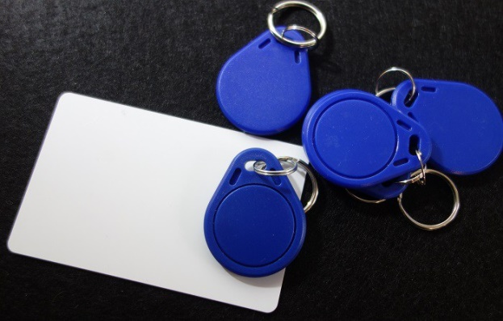
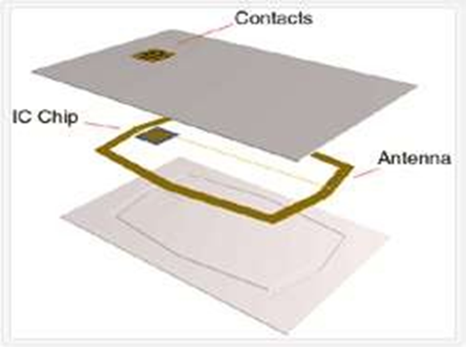
Types and Tags
1. Active:
Tag signal availability of 100ft.
High signal strength.
example: Railway cars on a track.
2. Passive:
Tag signal availability < 10 ft.
Very low signal strength.
Widely used because very cheap to make.

Slide 6
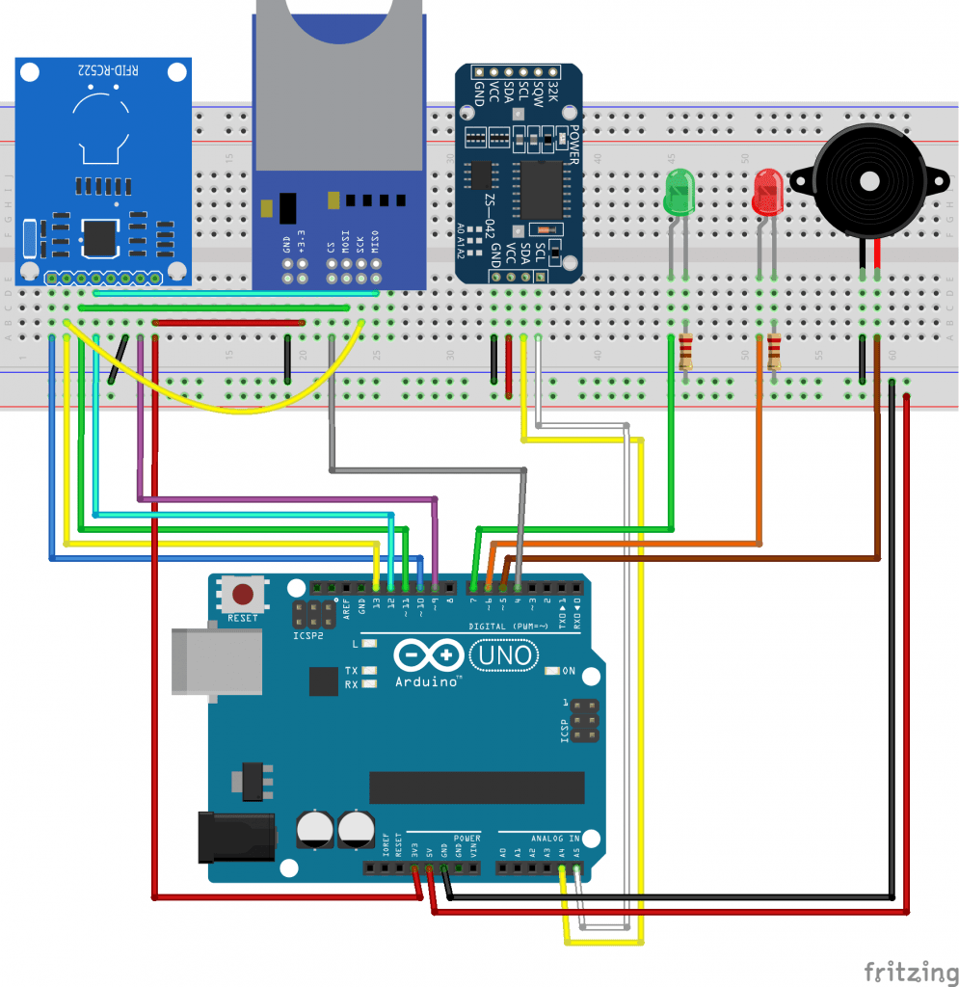

Schematic Diagram

Slide 7
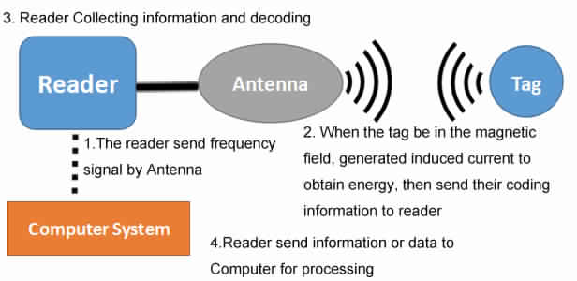
Working
RFID tag is detected by the reader module when in the range of 10 cm.
This card receives signal from reader and gives a return signal with ID number.
After reading the card it checks the database and decides whether card is duplicate or not.
According to database the controller increases the count for that specific lecture and stores it in the database.

Slide 8
Conclusion
This project is a full system for student monitoring in colleges, and high education institutes.
The device is supported with friendly using software for data analysis and previewing .
Lecturers need no more wasting time, and effort to have their attendance register .
Attendance register can easily be uploaded/updated to the database.

Slide 9
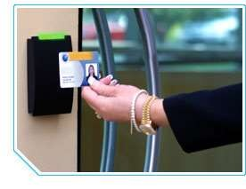
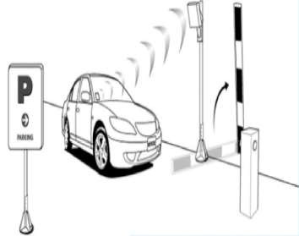
Applications
Identification
Logistics
Asset Management
Employee attendance
Parking
Payment
Access Control
Product Tracking

Slide 10
Thank You

